Slide 2
SLEEP IN HEAVENLY PEACE
NO KID SLEEPS ON THE FLOOR IN OUR TOWN!

Slide 3
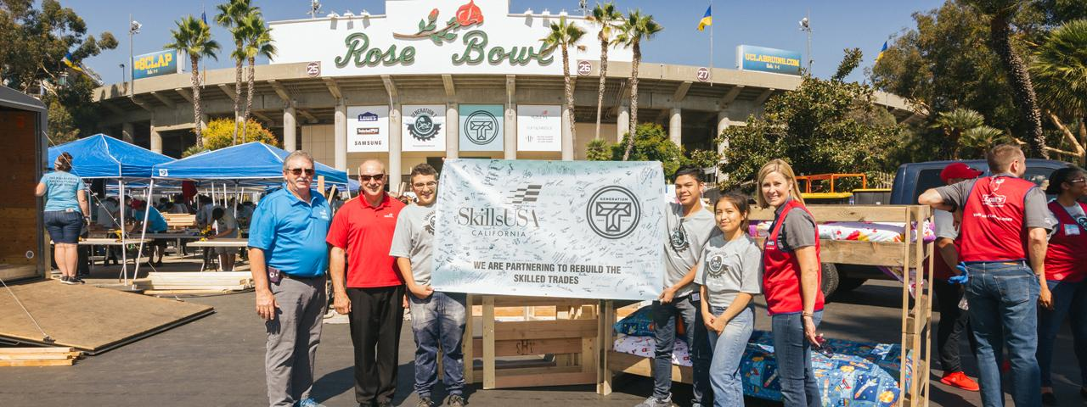
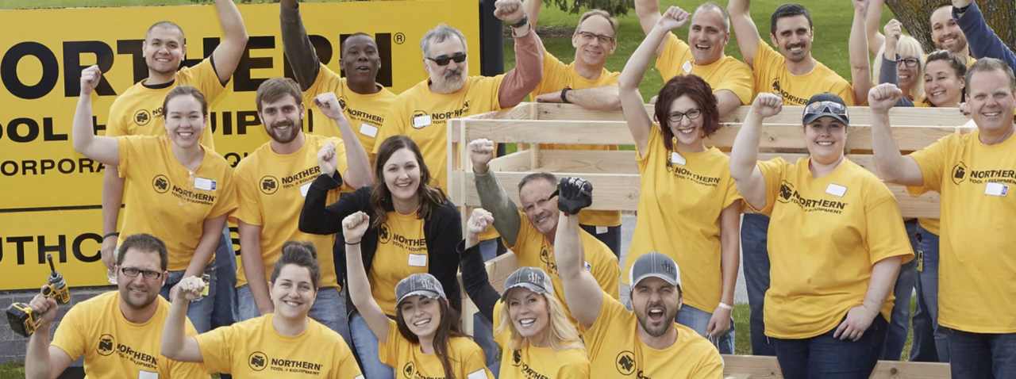
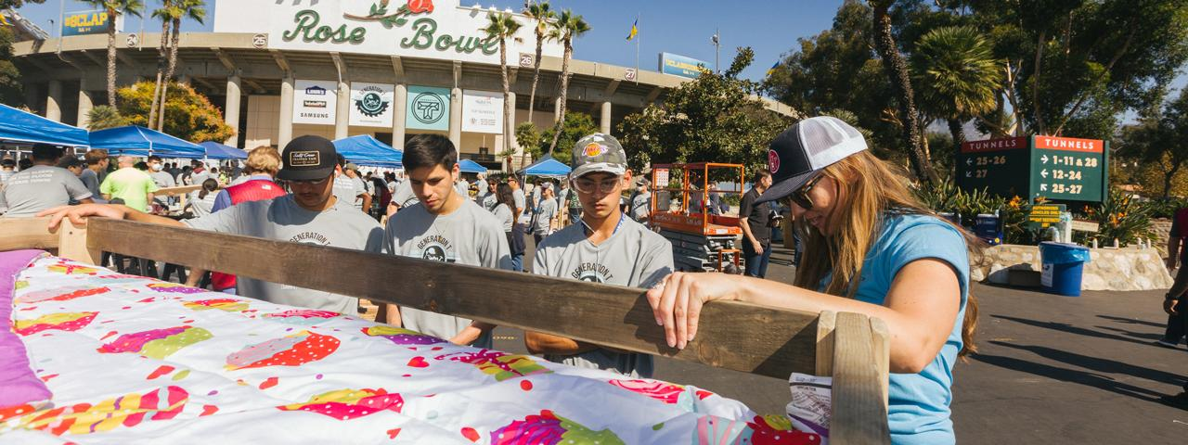
OUR MISSION
Getting Children Off the Floor!
We believe that “No kids sleeps on the floor in our town”, but we want to make OUR town EVERYONE’S town.
Bring Communities Together!
It takes the community to get involved and help their own. SHP provides the opportunity for Volunteers to do just that.

Slide 4
Sleep In Heavenly Peace – Is there a need??
Is there a need to help kids in Columbia County???

Slide 5
Columbia County, Florida – THE NEED
Columbia County Florida Population (2023)
70,385 People
Columbia County Florida Poverty Rate (2021)
16.5%
= 11,613 People
(Based on US Census Bureau)

Slide 6
Columbia County (cont’d) – THE NEED
In 2022 Columbia County had 63 children removed from their family situation
0-5 years old = 31 removed 6-17 years old = 32 removed
Sleep in Heavenly Peace projects 3% of US population represents kids sleeping on the floor or couches
(assume U.S population = 300M people = approx. 9M kids

Slide 7
Columbia County (cont’d) – THE NEED
So how many Columbia County kids are there with no beds??
          We know it is > than 0!!!
There is no other organization in Columbia County!!

Slide 8
Sleep in Heavenly Peace
National SHP Growth

Slide 9
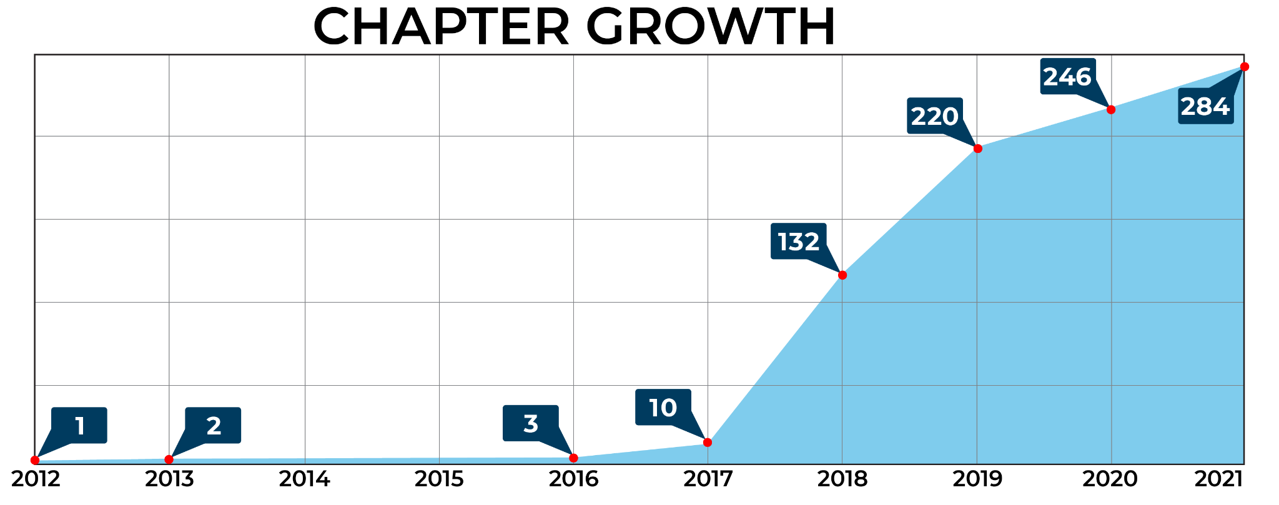
SHP GROWTH
At the end of 2018, we had received over 9,932 bed requests nationwide, putting our average over 75 kiddos a day requesting beds to sleep in.
In 2019, we added another 88 chapters to reach far more children but bed requests increased to 26,968.

Slide 10
THE NEED
Each Year, SHP has shown tremendous growth and has built almost 100,000 beds as of 2021. We know there will be even more need in the future.
YEAR
CHILDREN WE’VE HELPED GET OFF THE FLOOR
2012
22
2013
50
1 New Chapter
2014
102
2015
154
2016
270
1 New Chapter
2017
1,225
6 New Chapters
2018
8,288
125 New Chapters
2019
30,026
53 New Chapters
2020
20,378
34 New Chapters
2021
33,380
40 New Chapters

Slide 11
Sleep in Heavenly Peace – BED DATA
2025 To Date (Nation wide)
Total Beds Built: 42,638
Volunteers: 267,5485
Beds Delivered: 36,212
Chapters: 31
(Data 7-2-25)

Slide 12
Sleep in Heavenly Peace – BED DATA
Total 2012-2025 (Nation wide)
Total Beds Built: 317,852
Total Volunteers: 831,123
Total Beds Delivered: 292,235
Total Chapters: 427
(Data 7-2-25)

Slide 13
Sleep in Heavenly Peace
What is happening in Florida??

Slide 14
Sleep in Heavenly Peace – Florida Chapters
Florida Chapters (13)
FL- Fort Lauderdale
FL- Fort Walton Beach
FL- Gainesville
FL- Lake City – started October 2022!!
FL- Monticello
FL- Orlando W
FL- Palm Beach W

Slide 15
Sleep in Heavenly Peace – Florida Chapters
Florida Chapters (13) (Cont’d)
FL- Panama City
FL- Pensacola
FL- Sarasota
FL- Southside Jax
FL- Tallahassee
FL- Tampa Bay

Slide 16
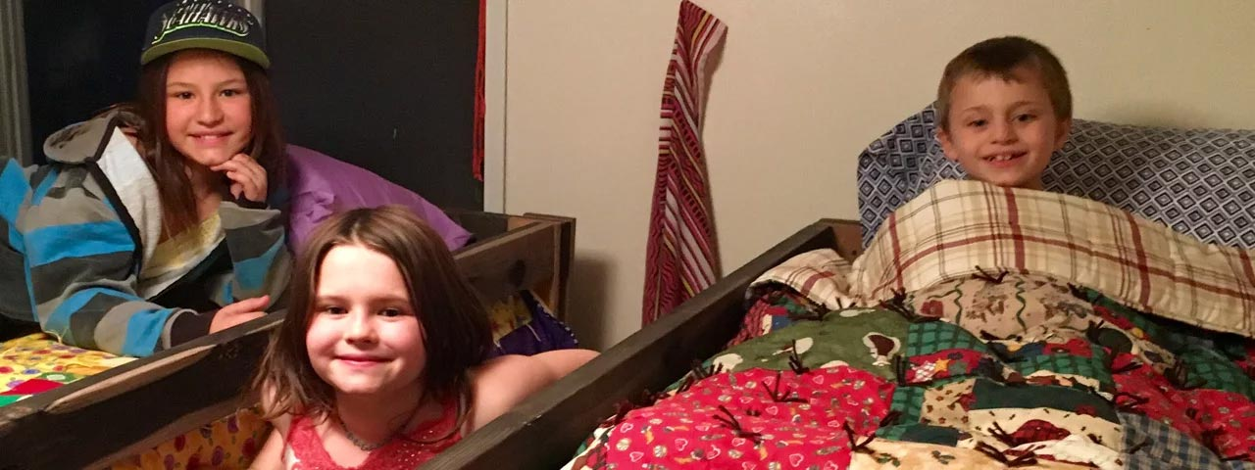
Sleep in Heavenly Peace - Application
How to apply for a bed?

Slide 17
Sleep in Heavernly Peace - Application
Family applies on SHP website
  Kids need to be between 3-17
  Columbia County only
  Single twin bed or twin-size Bunk Bed
Chapter President gets notification in Chapter website
  Begin Vetting Process
  Verify application
  Is it truly needed by the child?
  Sign Indemnification form before delivery

Slide 18
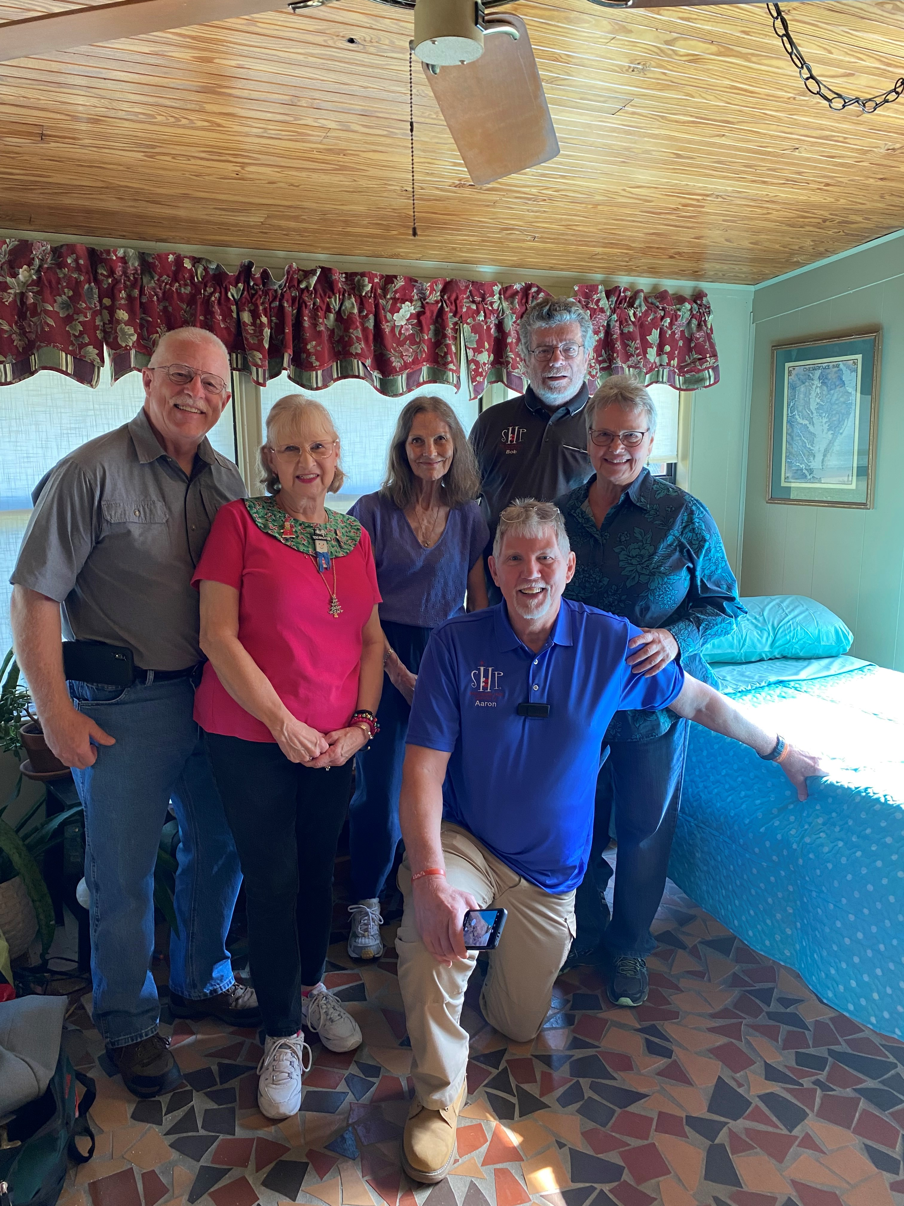
Sleep in Heavenly Peace - Application
Apply for a Bed (cont’d)
Schedule Delivery
Delivery Team
  Meet the family
  Assemble delivered bed
  Celebrate!!

Slide 19
Sleep in Heavenly Peace
Current Columbia County - Lake City Supporters
Lowes (National Supporter) Clay Electric Cooperative
Morrells Furniture Werner Industries
Christian Service Center Lake City Kiwanis
Lake City Lowes Lake City Reporter
1st Methodist Church Columbia High School
Columbia Mattress & Furniture Buck Rogers Foundation
Lake City Rotary Club Law Office of Chris Costello

Slide 20
Sleep in Heavenly Peace
Current Columbia County - Lake City Supporters
                ZSS
The Grace and Aloysius Harter Family Trust
Lake City Shriners Club
Columbia Builders Association
Lake City Industries

Slide 21
Sleep in Heavenly Peace
  Sponsorship
  5 Bunk Beds = 10 Single Beds approximately $2,500
  10 Bunks = 20 Single Beds approximately $5,000
  Volunteering
  1.5-2 people per bed plus additional support for setup and clean up
    10 beds: 15-20 people
    20 beds: 30-40 people

Slide 22
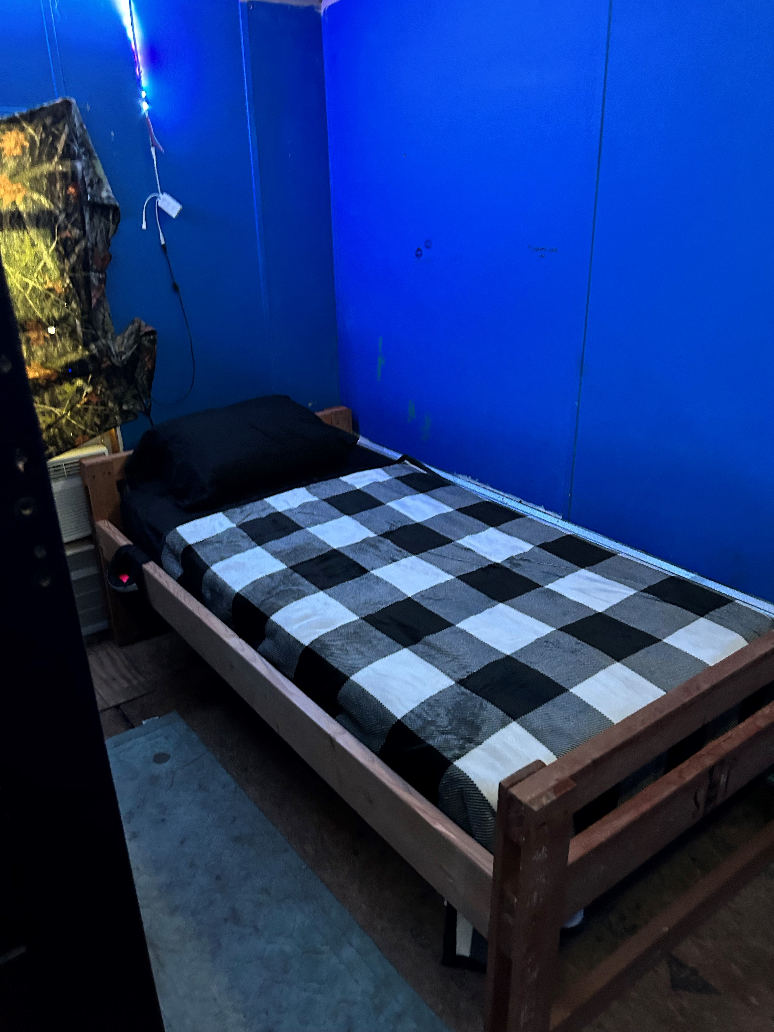
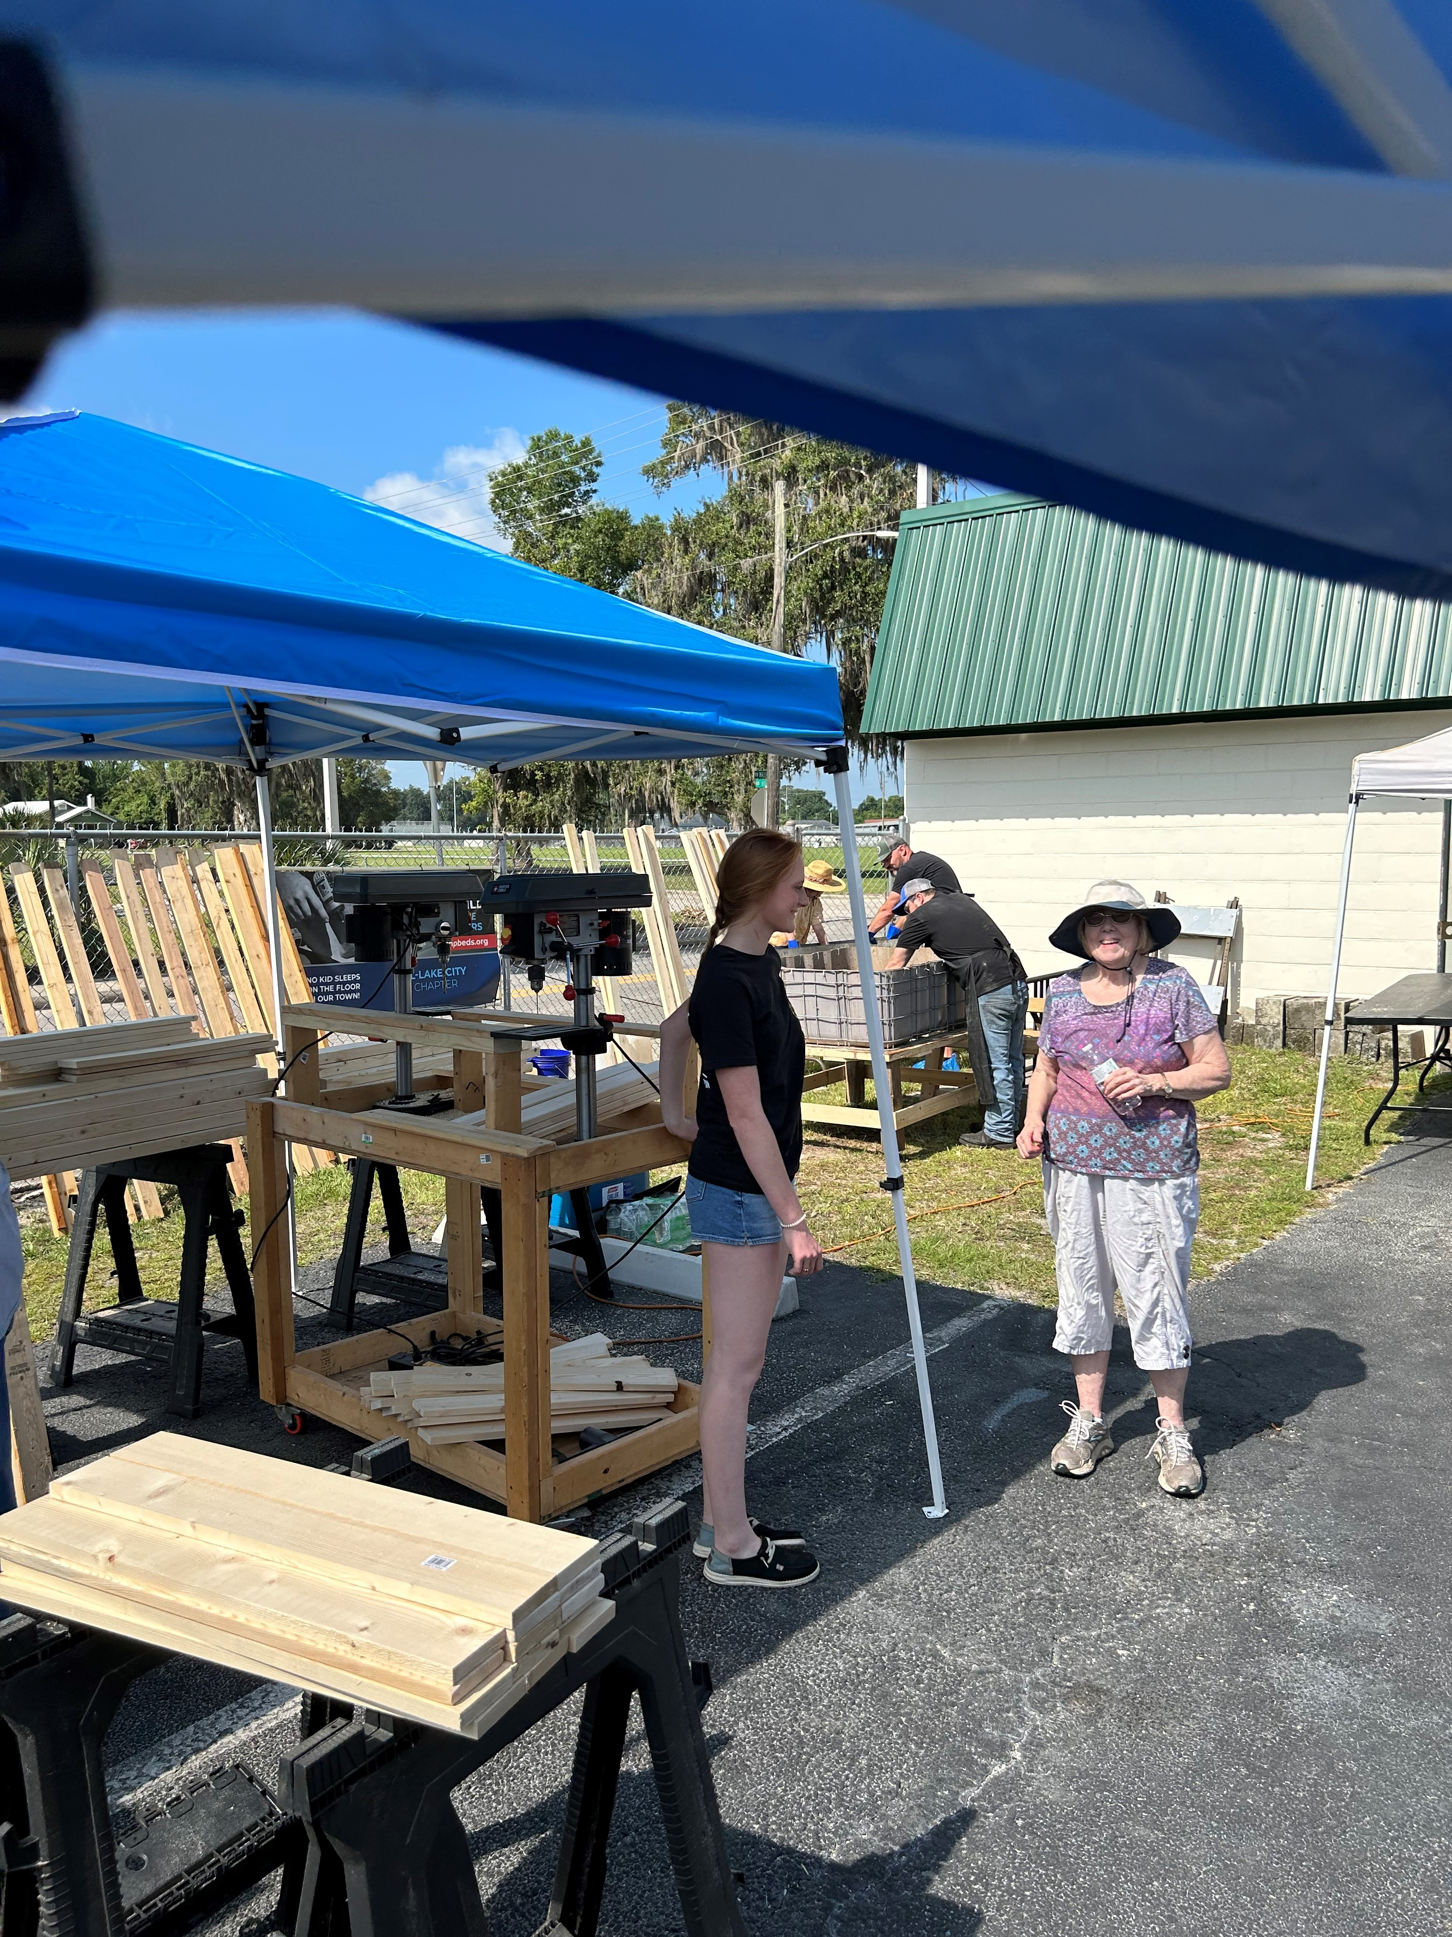
Sleep in Heavenly Peace
  6-20-23 Delivery
5-20-23 Build

Slide 23
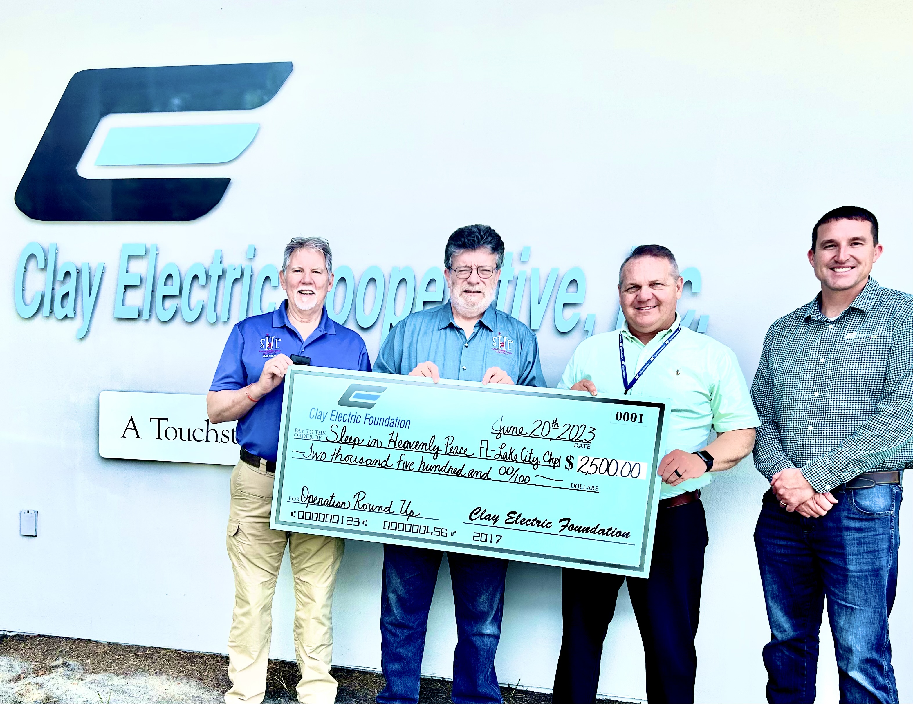
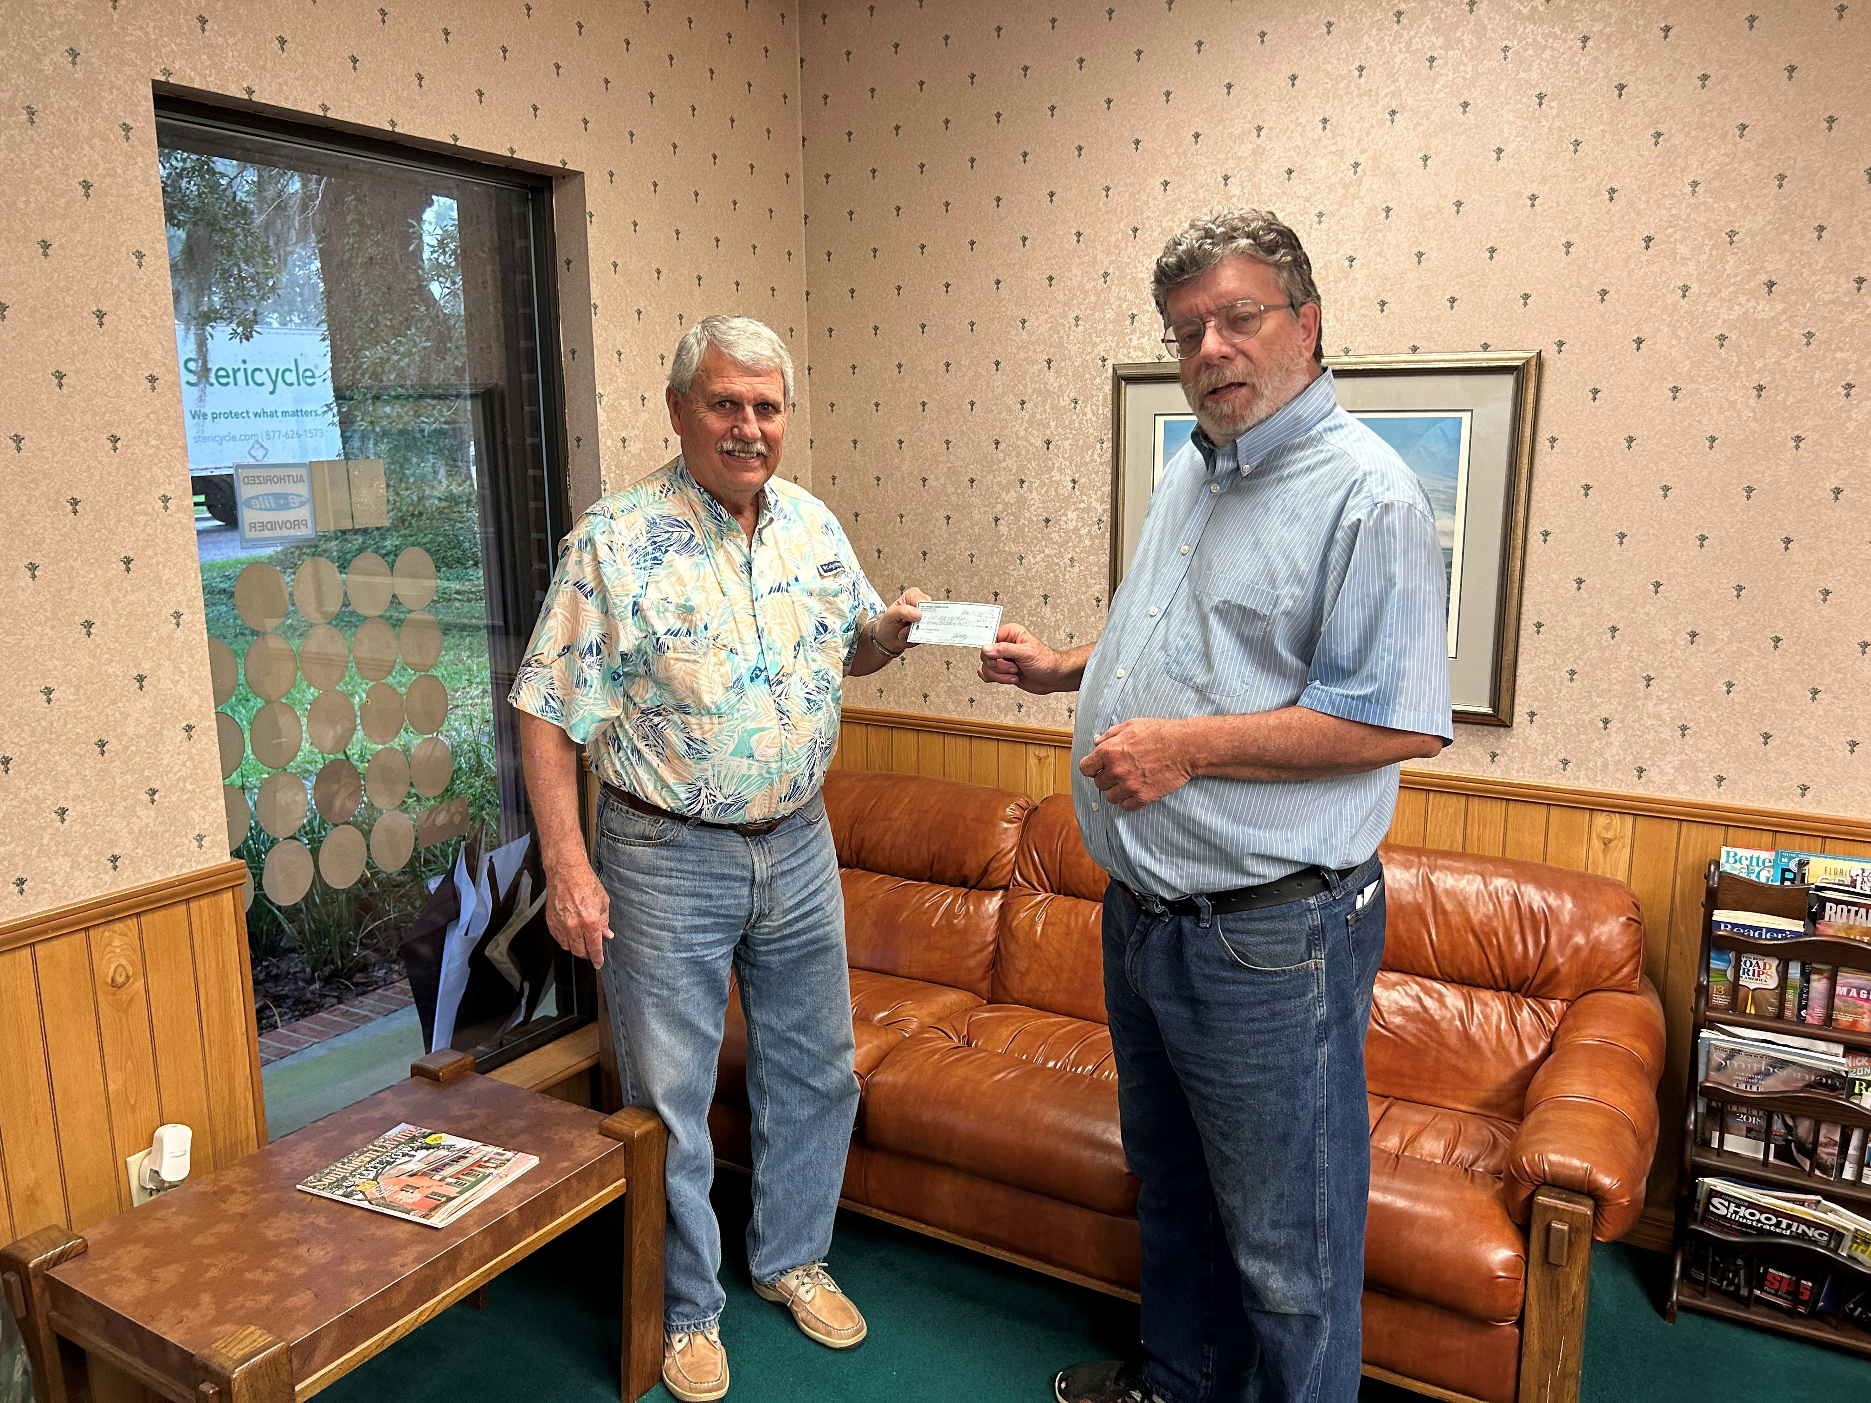
Sleep in Heavenly Peace
  Clay Electric Grant 6-20-23
Buck Rogers Foundation Grant 6-22-23

Slide 24
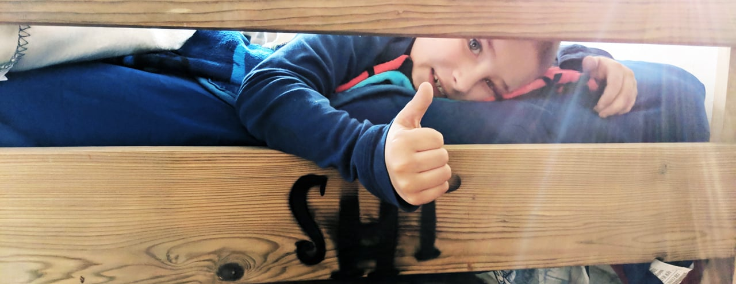
THANK-YOU!!

